Slide 1

7th Grade Math
Unit 2, Lesson 8 Simulating Small and Large Numbers of Trials Volume 1, pg. 73

Slide 2


Benchmark
MA.7.DP.2.4
Use a simulation of a simple experiment to find experimental probabilities and compare them to theoretical probabilities.
volume 1, pg. 73

Slide 3
Integrated Mathematical Thinking and Reasoning Standards
MA.K12.MTR.4.1 Engage in discussions that reflect on the mathematical thinking of self and others.
MA.K12.MTR.7.1 Apply mathematics to real-world contexts.
volume 1, pg. 73

Slide 4

Learning Targets
I can compare the experimental probability from a simulation to the theoretical probability of a simple experiment.
I can use results from computer-simulated events to informally define the Law of Large Numbers.
volume 1, pg. 73

Slide 5

Warm-Up
volume 1, pg. 73

Slide 6
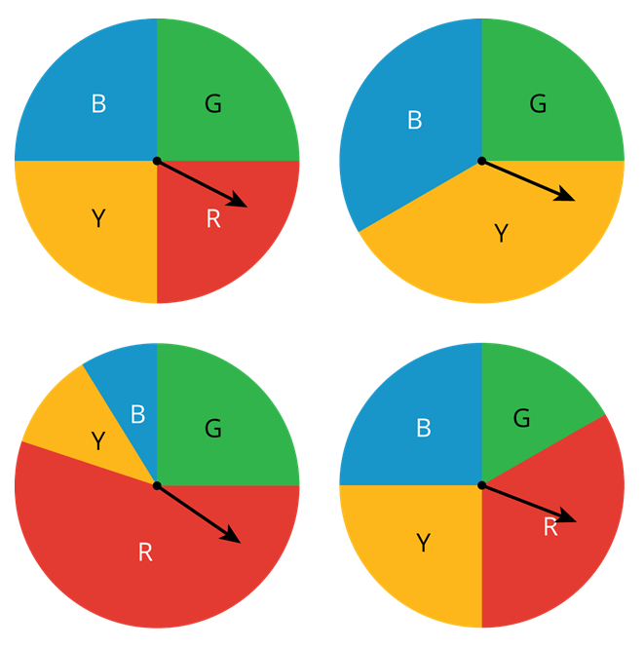
2.8.1 Warm-Up: Which One Doesn’t Belong?
Four spinners are shown.
Which spinner doesn’t belong?
Explain your reasoning.
volume 1, pg. 73

Slide 7

Exploration
volume 1, pg. 74

Slide 8

2.8.2 Exploration: Comparing Experimental Results to Expected Results
Work with your partner to complete the following.
When performing the simple experiment of flipping a coin over repeated trials, imagine each of the resulting situations listed in the table.
Complete the table to describe the results.
Situation | Is the result surprising? |  | Is the result possible?
 | Yes | No | Yes | No
You flip the coin once, and it lands heads-up. | ○ | ○ | ○ | ○
volume 1, pg. 74

Slide 9
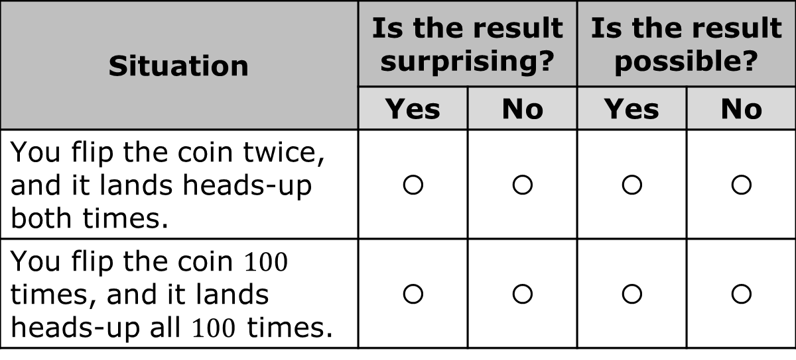
Situation | Is the result surprising? |  | Is the result possible?
 | Yes | No | Yes | No
You flip the coin twice, and it lands heads-up both times. | ○ | ○ | ○ | ○
You flip the coin $100$ times, and it lands heads-up all $100$ times. | ○ | ○ | ○ | ○
volume 1, pg. 74

Slide 10
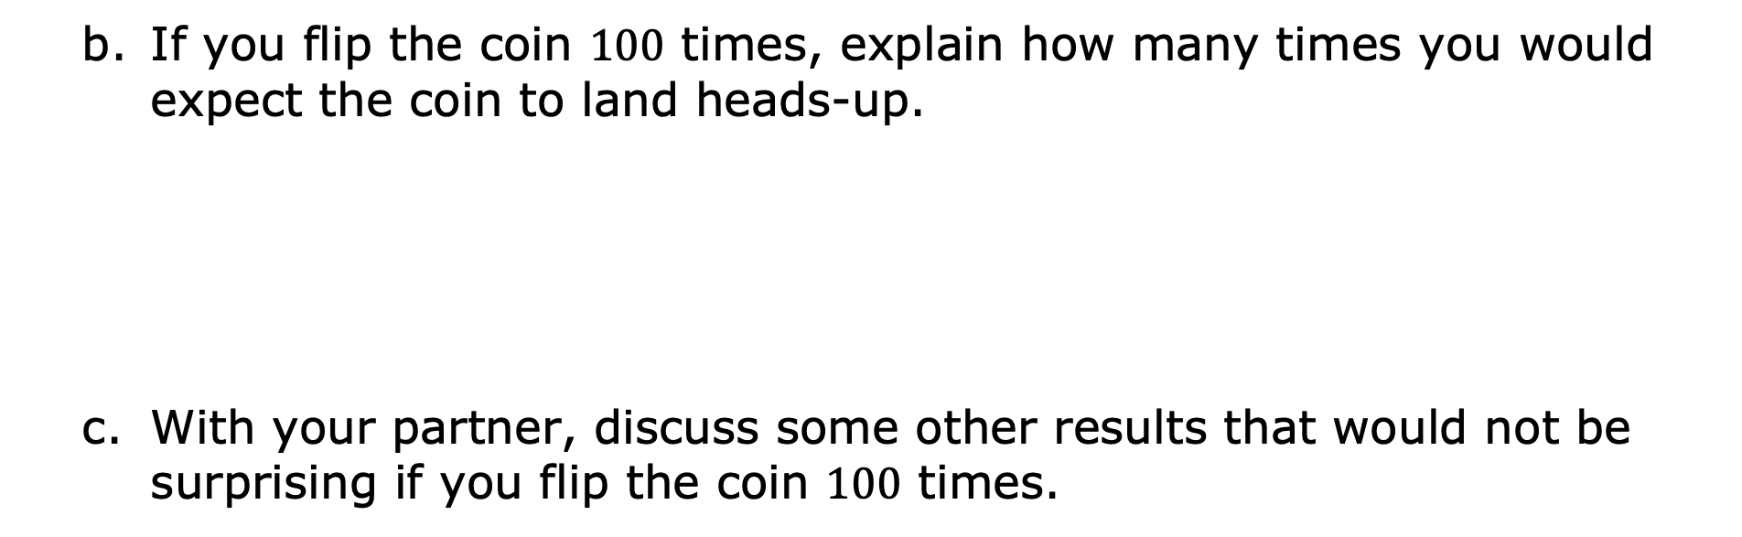
If you flip the coin $100$ times, explain how many times you would expect the coin to land heads-up.
With your partner, discuss some other results that would not be surprising if you flip the coin $100$ times.
volume 1, pg. 74

Slide 11
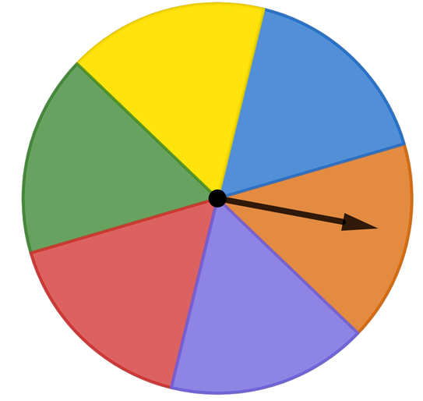
A spinner is shown.
Find the theoretical probability of landing on each color as a percentage rounded to the nearest tenth.
Color | Red | Purple | Orange | Blue | Yellow | Green
Theoretical Probability
volume 1, pg. 74

Slide 12
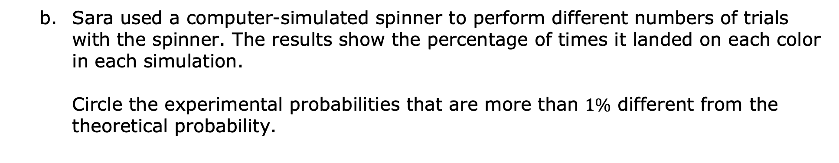
Sara used a computer-simulated spinner to perform different numbers of trials with the spinner. The results show the percentage of times it landed on each color in each simulation. Circle the experimental probabilities that are more than $1\%$ different from the theoretical probability.
Color | Red | Purple | Orange | Blue | Yellow | Green
Simulation A (6 spins) | 0% | 16.7% | 16.7% | 33.3% | 0% | 33.3%
Simulation B (60 spins) | 16.7% | 15% | 20% | 13.3% | 10% | 25%
Simulation C (600 spins) | 17.7% | 19% | 18% | 15.8% | 14.5% | 15%
Simulation D (6000 spins) | 16.9% | 16% | 17.1% | 16.6% | 16.7% | 17.1%
volume 1, pg. 74

Slide 13
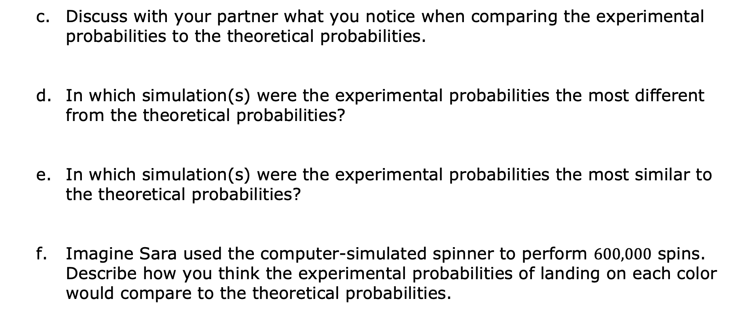
Discuss with your partner what you notice when comparing the experimental probabilities to the theoretical probabilities.
In which simulation(s) were the experimental probabilities the most different from the theoretical probabilities?
In which simulation(s) were the experimental probabilities the most similar to the theoretical probabilities?
Imagine Sara used the computer-simulated spinner to perform $600,000$ spins. Describe how you think the experimental probabilities of landing on each color would compare to the theoretical probabilities.
volume 1, pg. 75

Slide 14

Bring It Together
volume 1, pg. 75

Slide 15


2.8.3 Bring It Together: Comparing Experimental Results to Expected Results
A simulation is an approximate imitation of a statistical experiment, often done with a computer program to examine the statistics of a large quantity of trials.
Complete the statement.
As the number of trials in a simulation of a simple
experiment increases, the probability
gets the probability.
experimental
theoretical
closer to
farther from
experimental
theoretical
volume 1, pg. 75

Slide 16


Imagine flipping a coin $3$ times, and it has come up heads once. The experimental probability of landing on heads after $3$ trials is $\frac{1}{3}$. Discuss with your partner whether flipping the coin one more time is guaranteed to result in landing on heads so the experimental probability, $\frac{2}{4}$, will equal the theoretical probability $\frac{1}{2}$.
Simulations are useful when it is hard or time consuming to gather enough information to estimate the probability of some event.
When performing simple experiments, the experimental probabilities may differ from theoretical probabilities due to random variation. However, as the number of repetitions increases, experimental probabilities will typically better approximate the theoretical probabilities.
volume 1, pg. 75

Slide 17
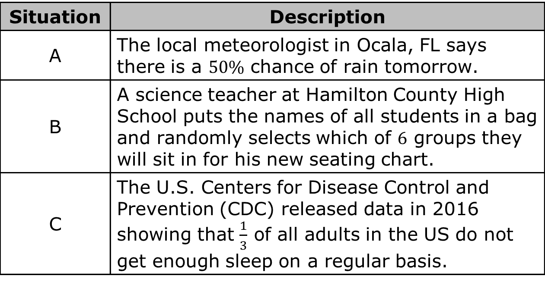
Consider the situations described in the table.
Explain which situation could be simulated using the spinner from the Exploration.
Situation | Description
A | The local meteorologist in Ocala, FL says there is a $50\%$ chance of rain tomorrow.
B | A science teacher at Hamilton County High School puts the names of all students in a bag and randomly selects which of $6$ groups they will sit in for his new seating chart.
C | The U.S. Centers for Disease Control and Prevention (CDC) released data in 2016 showing that $\frac{1}{3}$ of all adults in the US do not get enough sleep on a regular basis.
volume 1, pg. 76

Slide 18

Try It
volume 1, pg. 76

Slide 19

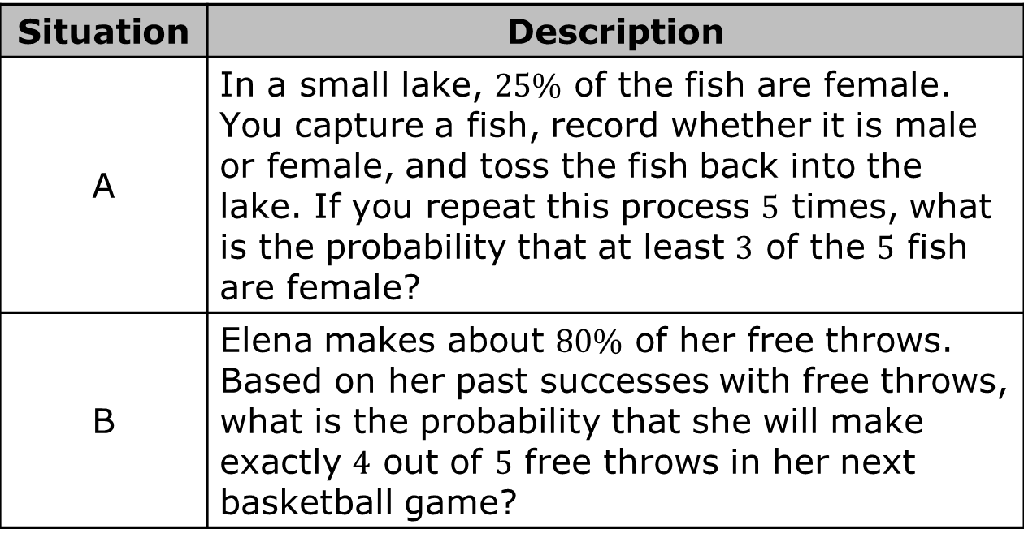
2.8.4 Try It: Using Simulations to Determine Experimental Probabilities
Four situations are described.
Situation | Description
A | In a small lake, $25\%$ of the fish are female. You capture a fish, record whether it is male or female, and toss the fish back into the lake. If you repeat this process $5$ times, what is the probability that at least $3$ of the $5$ fish are female?
B | Elena makes about $80\%$ of her free throws. Based on her past successes with free throws, what is the probability that she will make exactly $4$ out of $5$ free throws in her next basketball game?
volume 1, pg. 76

Slide 20
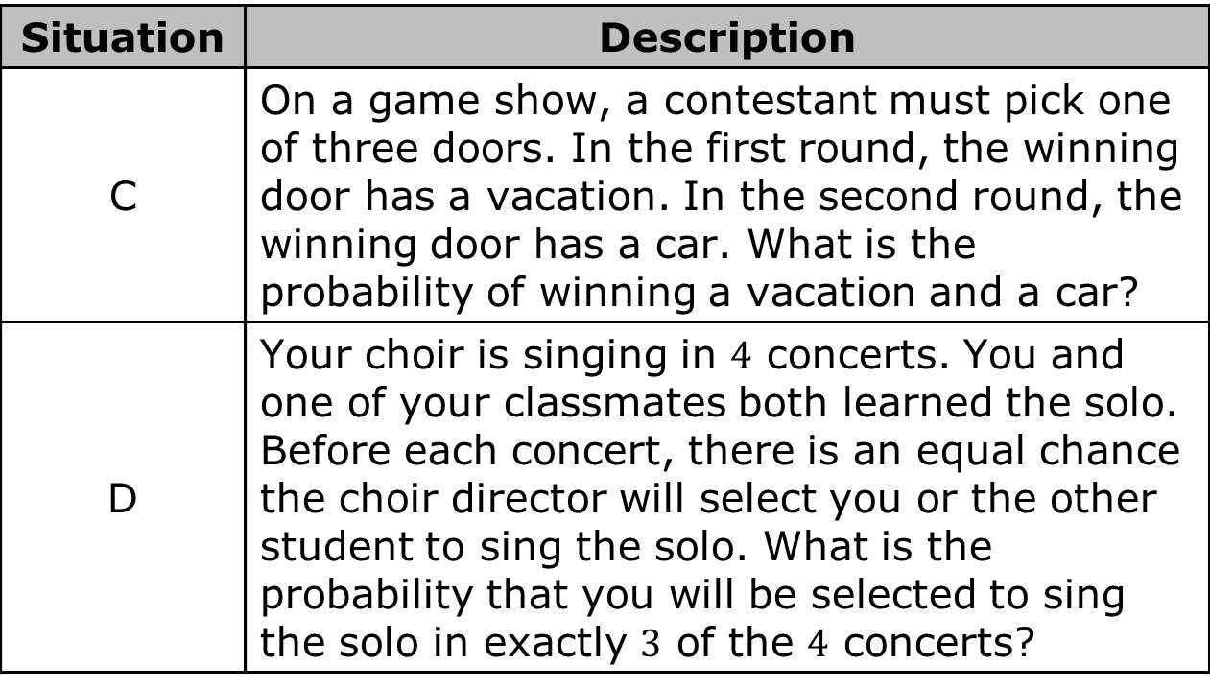
Situation | Description
C | On a game show, a contestant must pick one of three doors. In the first round, the winning door has a vacation. In the second round, the winning door has a car. What is the probability of winning a vacation and a car?
D | Your choir is singing in $4$ concerts. You and one of your classmates both learned the solo. Before each concert, there is an equal chance the choir director will select you or the other student to sing the solo. What is the probability that you will be selected to sing the solo in exactly $3$ of the $4$ concerts?
Work with your partner to match each situation to a simulation on the next page.
volume 1, pg. 76

Slide 21
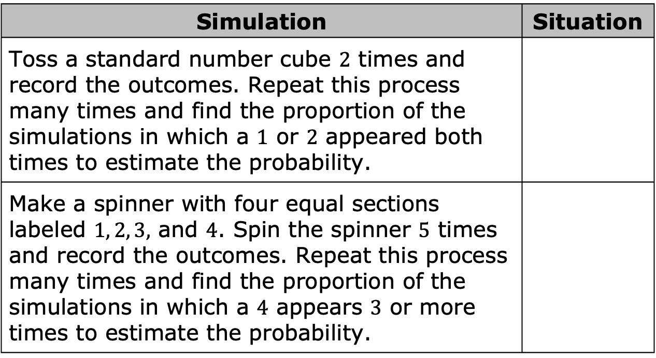
Simulation | Situation
Toss a standard number cube $2$ times and record the outcomes. Repeat this process many times and find the proportion of the simulations in which a $1$ or $2$ appeared both times to estimate the probability.
Make a spinner with four equal sections labeled $1, 2, 3,$ and $4$. Spin the spinner $5$ times and record the outcomes. Repeat this process many times and find the proportion of the simulations in which a $4$ appears $3$ or more times to estimate the probability.
volume 1, pg. 77

Slide 22
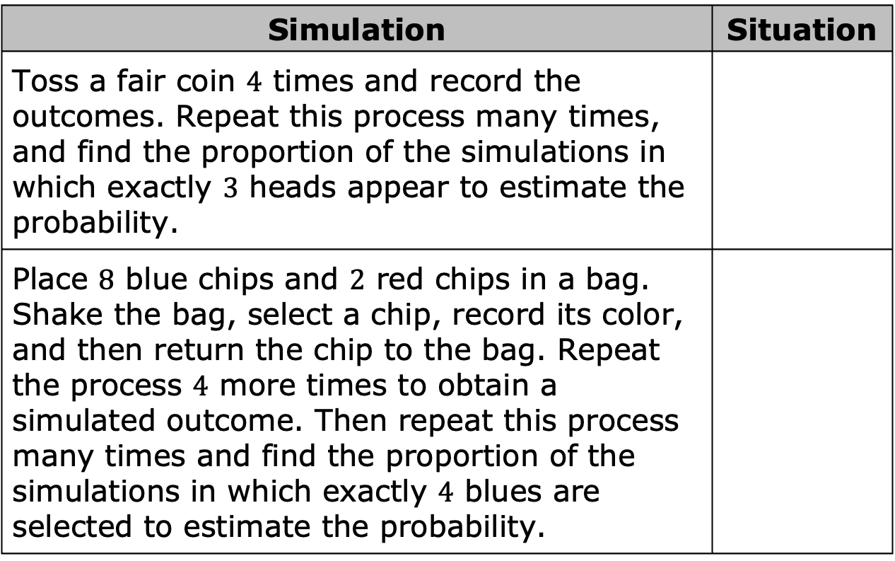
Simulation | Situation
Toss a fair coin $4$ times and record the outcomes. Repeat this process many times, and find the proportion of the simulations in which exactly $3$ heads appear to estimate the probability.
Place $8$ blue chips and $2$ red chips in a bag. Shake the bag, select a chip, record its color, and then return the chip to the bag. Repeat the process $4$ more times to obtain a simulated outcome. Then repeat this process many times and find the proportion of the simulations in which exactly $4$ blues are selected to estimate the probability.
volume 1, pg. 77

Slide 23

Wrap-Up
volume 1, pg. 77

Slide 24
2.8.5 Wrap-Up: Reflection
What is something that is now “squared away” in your mind about simulating the probability of events?
volume 1, pg. 77

Slide 25
What are three “points” that are important about simulating the probability of events?
What is something that is still “circling” your brain about simulating the probability of events?
volume 1, pg. 77

